Slide 1
Climate legislation

Slide 2
Climate legislation
Legislation
Paris Agreement and Rulebook
National circumstances and priorities
Others: politics, donor pressure, resources, etc.

Slide 4
Paris Agreement 1
Nationally determined mitigation contributions (NDCs) every 5 years
Parties shall pursue measures with the aim of achieving the objectives of such contributions (Art.4.2)
Principle of progression
First transparency/inventory report by 31/12/2024 then every other (biennial) year

Slide 5
Paris Agreement 2
Developed country parties shall report on financial flows, technology transfer and capacity building support (Art.13.9)
All parties should, as appropriate,
- Engage in adaptation planning and action (Art.7.9)
- Submit and update an adaptation communication (e.g. priorities, support needed, action) (7.10)
- report on climate change impacts and adaptation (13.8)
All shall undergo expert review process and participate in facilitative, multilateral consideration of progress (13.9)

Slide 6
Paris Agreement implementation
Paris Agreement - international law between States
Rules, methods, processes etc. adopted on the implementation of the Agreement (COP decisions, “Rulebook”, Outcome work program)
National implementation by parties to the Agreement
Policy, laws, decrees, regulations, by-laws, economic instruments, climate empowerment etc.

Slide 7
Law & regulations v other means 1
Paris Agreement does not specify how parties are to implement their NDCs
Legislation, regulations, policy, policy instruments, economic tools (taxes), programmes, climate actions etc.
National strategies and policies may address immediate climate concerns and formal legislation (by parliament) could hamper quick progress

Slide 8
Law & regulations v other means 2
Legislation ensures transparency, predictability and the application of common criteria across the board
Legitimacy and authority to regulate citizens’ activities
Locks countries in a policy direction that cannot be easily reversed
Encourages coordination of different policy spheres across government agencies
Allows the use of national accountability and enforcement mechanisms
Legal certainty and a robust legal framework are components of economic stability, working markets and attracting investment

Slide 9
Big issues
Adoption of a bespoke climate framework law or review of existing legislation?
Priority areas for legislative review and reform? E.g. review and amendments to the coastal protection, land management or building regulations in the light of expected climate change impacts; emergency response, risk assessment, insurance, finance, agriculture, health, traffic, pollution…
Establishing independent bodies to coordinate the national response to climate change, its possible mandate and composition?

Slide 10
Governance
General policy body | Advice and expertise | Implementation | Oversight
Commission, National Committee, Inter-ministerial Commission | Advisory board, Technical expert panel, Stakeholder consultative bodies | Secretariat, Office, Directorate, Agency, Ministries | Congress oversight committee, Evaluation Committee
National Council on Climate Change | Technical Advisory Committee, National Climate Change Agency | Agency, State & local governments, ministries, departments and agencies

Slide 11
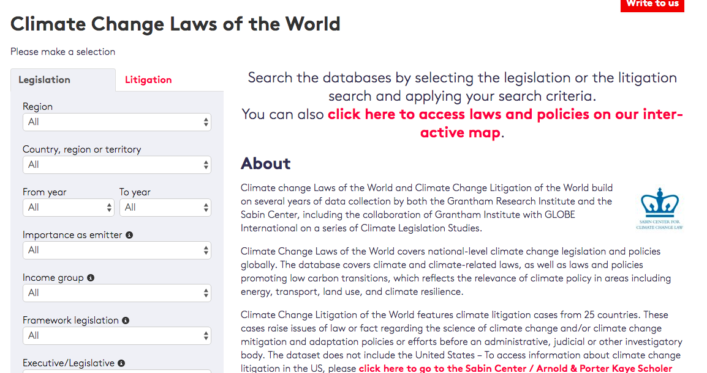
http://www.lse.ac.uk/GranthamInstitute/climate-change-laws-of-the-world/

Slide 12
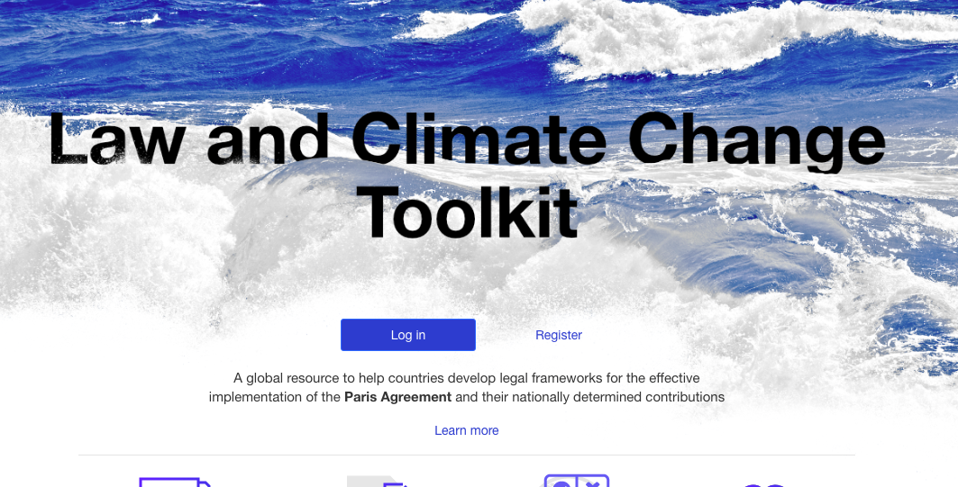
https://lcc.eaudeweb.ro/

Slide 13
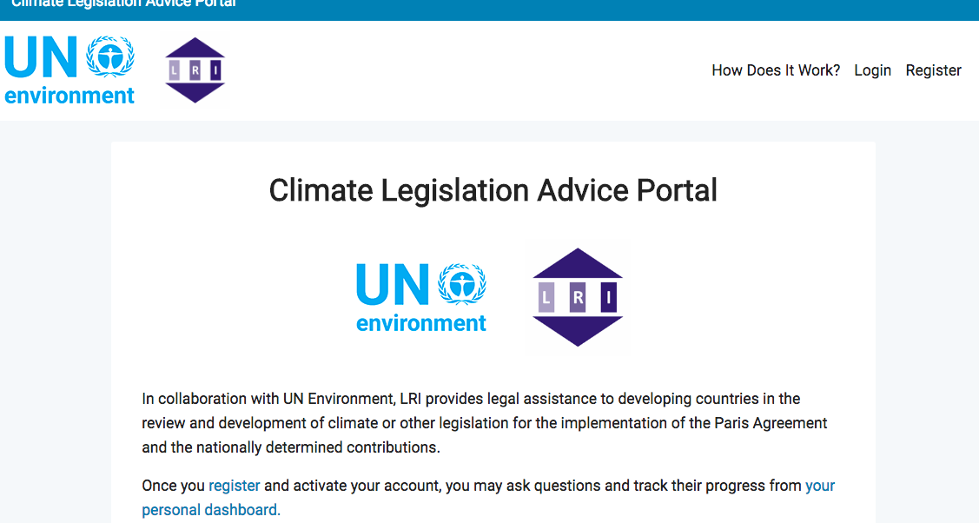
https://climatelegislation.org/

Slide 14
Design questions 1
Process and bodies v substance?
Link to NDCs (bottom up) and progression
Low carbon development strategy
Mainstreaming policies/new policies
Reporting and documenting climate impacts and adaptation action
Gender responsive, participatory and fully transparent approach taking into account vulnerable groups, communities and ecosystems (Art.7.5)
Planning, emergency preparedness, disaster risk reduction etc.

Slide 15
Design questions 2
Define needs and financial implications re adaptation, technology transfer, capacity building
Availability of finance
Existing legal landscape and relationship with other laws and regulations
Adoption of secondary legislation or further policies (mandates, timelines)
Sanction regimes
Economic tools, awareness raising, etc.

Slide 16
Law development process
Stakeholder consultation processes: participatory, transparent and inclusive (ownership facilitates compliance)
Legislative drafting:
Structure and format of bills and acts
Translating substantive issues into legal language
Ethos and technical skills
Types and components of legislative sentences
Language, grammar and punctuation
Parliament, private member’s bill, presidential decree….

