Slide 1
COP 29 briefing
Pascale Bird, Olivia Tattarletti and Monserrat Madariaga
Legal Response International

Slide 2
OVERVIEW
Finance and the New Collective Quantified Goal
The Global Stocktake, NDCs and Mitigation Work Programme
Adaptation
Loss and Damage
Just Transition
Response measures

Slide 3
FINANCE AND THE NCQG

Slide 4
Finance under the UNFCCC
In the context of CBDRRC, developed countries have financial obligations towards developing countries to support the implementation of their commitments under the Convention and the Paris Agreement.
‘The developed country Parties (…) shall provide new and additional financial resources.’ (Article 4.3 UNFCCC)
‘The extent to which developing country Parties will effectively implement their commitments under the Convention will depend on the effective implementation by developed country Parties of their commitments under the Convention related to financial resources and transfer of technology (…)’ (Article 4.7 UNFCCC)
‘Developed country Parties shall provide financial resources to assist developing country Parties with respect to both mitigation and adaptation in continuation of their existing obligations under the Convention.’ (Article 9.1 PA)
‘Developed country Parties should continue to take the lead in mobilizing climate finance from a wide variety of sources, instruments and channels’ (Article 9.3 PA).
Introduction to LRI
Climate negotiations – in context
Implementation at national level
Final considerations
199Q1992&1992A

Slide 5
The New Collective Quantified Goal: process
Collective goal for developed countries to jointly mobilise USD 100 b/year established at COP 15 (2009) and extended at COP 21. Assessment: insufficient, not delivered and unbalanced (GST1, 2023)
COP 21 (2015) when extending the previous goal decided that by 2025 the CMA 6 would set a NCQG from a floor of USD 100 B.
CMA 3 (2021) agreed on a process for deliberation between 2022 and 2023: ad hoc work programme (AHWP) with Technical Expert Dialogues (TEDs), high-level ministerial dialogues, stocktakes, and guidance by the CMA.
CMA 5 (2023) agreed to move to a mode of work that allowed to discuss on the basis of a draft decision.
2024 negotiations:
Second meeting of ADWP: 4 sessions during the Bonn negotiations. Co- hairs presented a 63 pages draft text.
10th and 11th TED: June and September.
High Level Ministerial Dialogue: 9 October 2024
Additionally, COP 29 Presidency facilitated an Informal heads of delegation meeting on the NCQG (8 October)
Input for the COP: New ADWP co-chair’s report including draft text, and report to the CMA.
Introduction to LRI
Climate negotiations – in context
Implementation at national level
Final considerations
199Q1992&1992A

Slide 6
COP 29: agreeing on the elements of the NCQG
Parties still need to agree on the key elements of the goal (and developed/developing countries are divided).
The quantum: how much. Consideration of developing countries needs/ bottom up and top-down approaches. SCF 2024 report only mapped 48% of needs.
The quality:
Forms: concessional? Grants? Loans? 72% of climate finance is debt based (OECD, 2023).Other innovative sources? See LRI literature review on sources of funding.
Allocation: accessible, predictable.
The nature and structure:
Mobilization or provision?
Single layer (which requires a clear definition of climate finance) or multi-layer (core for public finance).
Structuring allocation: subgoals? Including one on L&D? See LRI advice on arguments for and against a L&D subgoal.
Introduction to LRI
Climate negotiations – in context
Implementation at national level
Final considerations
199Q1992&1992A

Slide 7
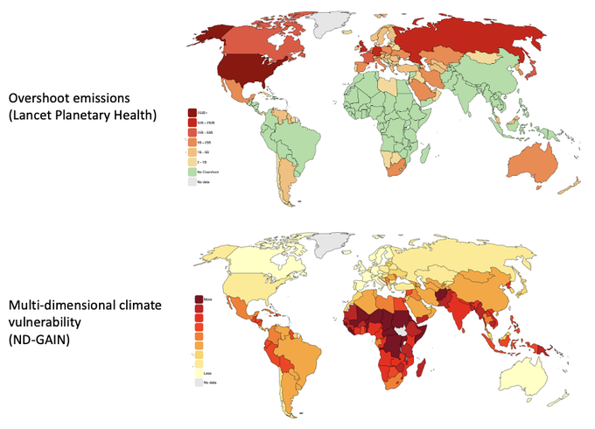
Contributors base:
No change: Developing countries position. Legal basis: financial obligations under the convention and the PA (to be implemented by the goal). CBDRRC.
Change: Developed countries position. This should be a global effort. Some emerging economies have grown and bear responsibility.
Introduction to LRI
199Q1992&1992A
Transparency and Monitoring: Link to the ETF or delegate to the SCF
Timeframe: a flexible goal

Slide 8
Link
Introduction to LRI
199Q1992&1992A

Slide 9
The Financial Mechanism
Operated by the Global Environmental Facility and Green Climate Fund (previously, the World Bank). Guidance from COP 29.
Least Developed Countries Fund.
Adaptation Fund (report on doubling of adaptation finance and governance at COP 29)
Loss and Damage Fund (COP 28). Report and guidance from COP 29.
The Standing Committee on Finance
Introduction to LRI
Climate negotiations – in context
Implementation at national level
Final considerations
199Q1992&1992A
These report to the COP/CMA, which provides guidance.

Slide 10
THE GST, NDCs and the
MWP

Slide 11
Global Stocktake (GST)
Assessment of Parties collective efforts towards the implementation of the the Paris Agreement purpose and long-term goals (Article 2 I a-c)
CMA 5 (2023) performed the first GST, as mandated by Article 14 of the Paris Agreement. Will take place every 5 years.
GST 1: Decision 1 CMA/5
193 paragraph decision capturing Parties' progress, gaps and challenges.
Emphasizes the “need for urgent action and support to keep the 1.5°C goal within reach.” But… few operative texts.
Due to inform next round of NDCs.
Fossil fuels: calls parties to ‘Transitioning away from fossil fuels in energy systems, in a just, orderly and equitable manner, accelerating action in this critical decade, so as to achieve net zero by 2050 in keeping with the science;’ and Phasing out of inefficient fossil fuel subsidies.
LRI advice on language on fossil fuels in the GST decision.
Introduction to LRI
Climate negotiations – in context
Implementation at national level
Final considerations
199Q1992&1992A

Slide 12
GST in 2024 and CMA 6/COP 29
‘UAE GST Dialogue’ focusing on implementing the GST outcomes, which will be operationalised from CMA 6 (2024) and conclude at CMA 10 (2028) – established in para. 97 of the GST 1 Decision.
SB 60 mandated to negotiate on the modalities, however, strong disagreement over scope arose. Is this to implement all GST outcomes or finance – related ones only?
COP 29 provisional agenda placed this dialogue under finance.
‘Annual GST Dialogue’ to facilitate sharing of knowledge on how the outcomes of the GST are informing the next round of NDC. – established in para. 187 GST decision and took place at SB 60.
GST 1 review: ‘Procedural and Logistical Elements of the Overall Global Stocktake Process’ –established by CMA 1. GST decision established it to commence at SB 60 and conclude at CMA 6.
Introduction to LRI
Climate negotiations – in context
Implementation at national level
Final considerations
199Q1992&1992A

Slide 13
Nationally Determined Contributions (NDCs)
NDCs are the driving (procedural) obligation of Parties under the PA: to submit and update a mitigation NDC. It captures what a Party intends to achieve.
Mitigation oriented regime. Developing countries tend to include adaptation, finance, L&D. Conditional elements in NDC (to support).
NOT a legally binding obligation of a specific outcome (at the international level), i.e. no requirement to “meet” or “comply with” their commitments. Might be enforceable at the national level.
Introduction to LRI
Climate negotiations – in context
Implementation at national level
Final considerations
199Q1992&1992A

Slide 14
New NDCs to be submitted in 2025
GST1 (para 167) reaffirmed that successive NDCs must “represent a progression beyond the Party’s current NDC and reflect its highest possible ambition”.
NEW NDCs (third generation) to be submitted in 2025.
GST annual dialogue on how the GST is informing the next round of NDCs. Summary report.
IISD report on How the Transition Away From Fossil Fuel Production (GST 1) can be included in new NDCs (June 2024). Only one from the 20 biggest FF producing countries mention decreasing production (EU).
Introduction to LRI
Climate negotiations – in context
Implementation at national level
Final considerations
199Q1992&1992A

Slide 15
Mitigation Work Programme (MWP)
CMA 3 (2021) Parties established a work programme to urgently scale up mitigation ambition and implementation in this critical decade, complementary to the GST.
CMA 4 (2022) Parties agreed on the scope and format of the MWP, which became known as the “Sharm el- Sheikh mitigation ambition and implementation work programme.”
2023/2024: Two dialogues on accelerating a just energy transition in 2023 and ahead of SB 60 (2024), a third dialogue and investment-focused event was held centred on ‘Cities: buildings and urban systems.’
SB60: Parties were invited to share views on these events and found strong disagreement. Some Parties wanted the MWP to be linked to GST outcomes(specially on FF) while LMDC and Arab Group opposed to such linkages. Rule 16.
Informal note and draft decision published by co- facilitators.
Provisional agenda for SBSTA 61 and SBI 61. Report by the Secretariat.
Introduction to LRI
Climate negotiations – in context
Implementation at national level
Final considerations
199Q1992&1992A

Slide 16
ADAPTATION

Slide 17
Context
The effects of a changing climate are already being observed and experienced across the world. Developing countries are most affected.
Adaptation means taking measures to reduce the negative effects of climate change or exploit the positive ones, by making appropriate adjustments.
There is no one size fits all and interventions will vary, based on many factors, incl. local context.
Recognised under the UNFCCC, dedicated article in the Paris Agreement (Article 7, PA)

Slide 18
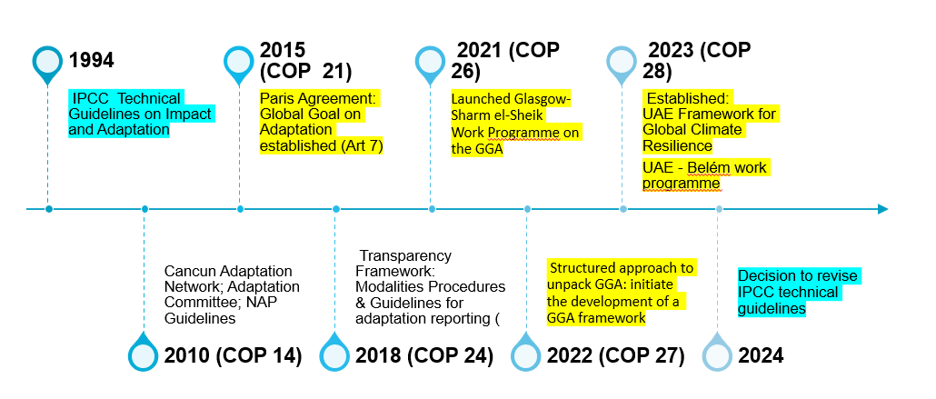
Key UNFCCC adaptation moments

Slide 19
Global Goal on Adaptation (GGA)
Article 7.1, PA: “Parties hereby establish the [GGA] of enhancing adaptive capacity, strengthening resilience and reducing vulnerability to climate change, with a view to contributing to sustainable development and ensuring an adequate adaptation response in the context of the temperature goal referred to in Article 2”
In Dubai in 2023 (Decision 2/CMA.5)
UAE Framework for Climate Resilience: a framework (voluntary targets) to guide the achievement of the GGA and review its overall progress was agreed
UAE – Belém work programme: A two-year programme to develop indicators to measure progress toward the targets was launched

Slide 20
What to expect at COP 29?
Disagreements persist in many areas, incl. inclusion of quantitative and qualitative targets to measure progress, embedding means of implementation in GGA framework, process versus outcome-based targets, etc.
Decision on who will lead the process of developing indicators (Adaptation Committee / experts); clarity on experts’ engagement in process and criteria for indicator identification
What is the final output expected in Belem?
Means of implementation: How to measure the gaps in finance, technology and capacity building?
Contribution to future global stocktakes

Slide 21
Other adaptation related negotiation themes
National Adaptation Plans: Parties are mandated to assess progress made towards the formulation and implementation of NAPs.
Review of the Adaptation Committee
Adaptation finance: GST1 acknowledged that funding for adaptation will need to be significantly increased beyond the doubling provided for in Decision 1/CMA.3 to meet the urgent and evolving need to accelerate adaptation

Slide 22
LOSS AND DAMAGE

Slide 23
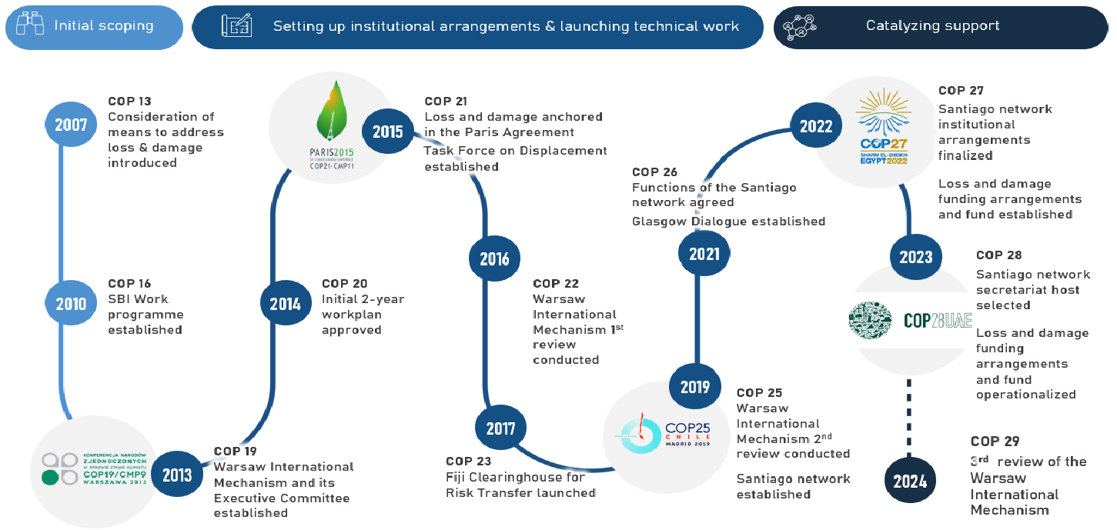
Milestones on Loss and Damage
Source: UNFCCC

Slide 24
Loss and Damage under the UNFCCC process
Warsaw International Mechanism (WIM)
Loss and Damage Fund and Funding Arrangements
Executive Committee
Santiago Network

Slide 25
Warsaw International Mechanism
COP19 (2013) established the Warsaw International Mechanism for Loss and Damage associated with Climate Change Impacts (WIM) as the main vehicle in the UNFCCC process to address loss and damage
Same decision also established its Executive Committee to guide the implementation of the WIM’s core functions:
Enhancing knowledge and understanding of comprehensive risk management approaches to address loss and damage;
Strengthening dialogue, coordination, coherence and synergies among relevant stakeholders; and
Enhancing action and support, including finance, technology and capacity-building, to address loss and damage associated with the adverse effects of climate change, to enable countries to undertake actions.

Slide 26
Santiago Network
CMA 2 (COP25): established the Santiago Network (SN) to catalyze technical assistance of organizations, bodies, networks and experts for the implementation of Loss & Damage
CMA 3 (COP26): agreed Network’s functions
CMA 4 (COP27): decided on operational modalities and Network’s structure, to include a secretariat, Advisory Body and a network of organisations, bodies, networks and experts (OBNEs)

Slide 27
Funding arrangements incl. a Loss and Damage Fund
COP27/CMA4 established funding arrangements, including a Fund, dedicated to Loss and Damage
COP28/CMA5 decisions operationalized the Fund and approved its Governing Instrument
The Fund, to be known as Fund for responding for Loss and Damage, will be a multilateral financing channel that aims:
“to assisting developing countries that are particularly vulnerable to the adverse effects of climate change, in responding to loss and damage with a focus on addressing loss and damage by providing and assisting in mobilising new and additional resources”

Slide 28
Recent developments and what to expect at COP29
WIM:
TORs for 3rd review of WIM (incl. ExCom) prepared at SB60; COP29/CMA6 to conduct WIM review
COP29/CMA to continue consideration of WIM governance
Annual report of the ExCom
Santiago Network:
Advisory Board met three times this year, deciding on headquarters location (Geneva), two-year work programme, indicative budget for 2024 and guidelines for designation of OBNEs, responding to requests for assistance, managing funding and conflicts of interest
AB will recommend draft rules of procedure for adoption at COP29/CMA6
Annual report of SN will be approved

Slide 29
Recent developments and what to expect at COP29
Fund for responding to Loss and Damage:
LDF Board met three times this year to start process of operationalising it. One more meeting scheduled in December. The Philippines to be host of the Board.
At last meeting, the Board appointed the first LDF Executive Director. It also approved all key documents that will allow World Bank to act as interim trustee and host the Fund’s secretariat
The fourth Board meeting will begin discussions on design of the Fund, incl. on modalities for direct access and direct budget support, minimum fiduciary standards and environmental and social safeguards for direct access entities, and a minimum allocation floor for LDCs and SIDS
At COP29, launch of the annual high-level dialogue on coordination and complementarity with reps of entities forming part of funding arrangements
Approval of contractual arrangements between COP, CMA and Fund to ensure it is accountable and functions under guidance of COP and CMA

Slide 30
JUST TRANSITION

Slide 31
Just transition - introduction
Features in two negotiation streams
Response measures
SBI/SBSTA - Matters relating to the forum on the impact of the implementation of response measures serving the Convention, the Kyoto Protocol and the Paris Agreement
COP/CMA/CMP - Report of the forum on the impact of the implementation of response measures
Just transition work programme (JTWP)
SBI/SBSTA - United Arab Emirates just transition work programme
CMA - United Arab Emirates just transition work programme
Introduction to LRI
Climate negotiations – in context
Implementation at national level
Final considerations
199Q1992&1992A

Slide 32
J T W P
Just transition work programme
JTWP established in 2022 in Egypt through Decision 1/CMA.4
Objective: discussing pathways to achieving the Paris Agreement goals under a just and equitable transition
Further developed in 2023 in the UAE through Decision 3/CMA.5
Modes of work:
Joint contact group convened at each of the SBI and SBSTA sessions
Two annual dialogues in hybrid format
An annual high-level ministerial roundtable
Introduction to LRI
Climate negotiations – in context
Implementation at national level
Final considerations
199Q1992&1992A

Slide 33
JTWP core elements
Just transition pathways to achieving the Paris Agreement goals under Article 2;
Just and equitable transition pathways that include energy, socioeconomic, workforce and other dimensions, based on nationally defined development priorities and including social protection;
Opportunities, challenges and barriers relating to sustainable development and poverty eradication;
Approaches to enhancing adaptation and climate resilience;
Just transition of the workforce and the creation of decent work and quality jobs;
Inclusive and participatory approaches;
International cooperation as an enabler of just transition pathways.
Broad remit: Different meanings of just transition and different priorities for transition pathways.
Introduction to LRI
Climate negotiations – in context
Implementation at national level
Final considerations
199Q1992&1992A

Slide 34
JTWP in 2024
Two dialogues have taken place:
2-3 June: “Just Transition pathways to achieving the goals of the Paris Agreement through NDCs, NAPs and LT-LEDs” SB Chairs’ informal summary (bit.ly/JTWPdialogue1)
2-3 October: “Ensuring support for people-centric and equitable just transition pathways with a focus on the whole-of-society approach and the workforce”
SBSTA/SBI 60 session in June in Bonn:
Discussions on a draft decision text on the implementation of the JTWP (no agreement)
Agreed to continue consideration of the matter at SB 61
CMA 6 (November 2024): annual summary report on the dialogues, negotiations with a view to recommending a draft decision to CMA 6, annual high-level ministerial round table on just transition
Introduction to LRI
Climate negotiations – in context
Implementation at national level
Final considerations
199Q1992&1992A

Slide 35
*Upcoming* just transition explainer
JTWP key issues
SB 60 informal note by co-chairs bit.ly/JTWPSB60
Lack of common understanding on the concept
Continuation of work:
Whether to request constituted bodies to report on integration of JT into their processes
A proposal from G77+China to establish a work plan for the work programme, opposed by the US
Modalities: whether existing ones are sufficient or additional ones are needed (e.g. some parties called for further dialogues)
Introduction to LRI
Climate negotiations – in context
Implementation at national level
Final considerations
199Q1992&1992A

Slide 36
RESPONSE MEASURES

Slide 37
Response measures - introduction
Mainly measures to reduce emissions
The Convention, the Kyoto Protocol, and the Paris Agreement all recognise that implementing response measures can impact countries’ economies
2011: Forum to understand and address these impacts was set up
2018: Katowice Committee of Experts on the Impacts of the Implementation of Response Measures (KCI) created to support the Forum’s work
Undertakes technical work, e.g. prepares case studies, technical papers etc.
Introduction to LRI
Climate negotiations – in context
Implementation at national level
Final considerations
199Q1992&1992A

Slide 38
LRI advice on the functions of the forum
bit.ly/RMforum
Response measures – forum & KCI
Single platform for the work of the COP, CMP and CMA on the issue
Common work programme and jointly implement a 6-year workplan
Work programme has 4 areas:
Economic diversification and transformation;
Just transition of the workforce and the creation of decent work and quality jobs;
Assessing and analysing the impacts of the implementation of response measures;
Facilitating and building capacity for the identification, development, customization and use of tools and methodologies to assess the impacts of the implementation of response measures.
Forum and KCI have 9 functions:
Provide a platform for countries to share information, experiences… with a view to recommending specific actions; provide recommendations to the SBs who then recommend them to the COP, CMP, CMA; promote action; enhance capacity; enhance cooperation; input to the GST; database of tool and methodologies…
Introduction to LRI
Climate negotiations – in context
Implementation at national level
Final considerations
199Q1992&1992A

Slide 39
Response measures in 2024
Forum convened at SBI 60 and SBSTA 60
Held 2 technical events on guidelines and policy frameworks to promote just transition within and across sectors, and on understanding the positive and negative impacts of low and zero- emission transportation technologies
Started developing its new five-year work plan
In discussions on the JTWP, G77+China expressed the view that it may no longer be beneficial to include JT within the KCI
At SB 61
KCI will consider updates to its rules of procedure
Forum will continue developing the work plan taking into account a “non-paper” containing a table of activities to recommend a draft decision for consideration and adoption at COP 29, CMP 19 and CMA 6
Introduction to LRI
Climate negotiations – in context
Implementation at national level
Final considerations
199Q1992&1992A

Slide 40
Other agenda items
Sharm el-Sheikh joint work on implementation of climate action on agriculture and food security (SBSTA/SBI)
Matters relating to the operation of the clean development mechanism (SBSTA/CMP)
Matters relating to Article 6 of the Paris Agreement (SBSTA/CMA)
Periodic review of the long-term global goal under the Convention and of overall progress towards achieving (COP)
Matters relating to technology development and transfer: joint annual report of the Technology Executive Committee and the Climate Technology Centre and Network (SBSTA/SBI/COP/CMA) + Technology implementation programme (CMA) + Linkages between the Technology Mechanism and the Financial Mechanism; and Poznan strategic programme on technology transfer (SBI/COP)
Reporting and review pursuant to Article 13 of the Paris Agreement: provision of financial and technical support to developing country Parties for reporting and capacity-building (SBI/CMA)
Matters relating to Action for Climate Empowerment (SBI), Gender and climate change (SBI/COP)
Research and systematic observation (SBSTA), Facilitating dialogues on mountains and climate change (COP)
Matters relating to capacity-building (SBI/COP/CMA/CMP)

Slide 41
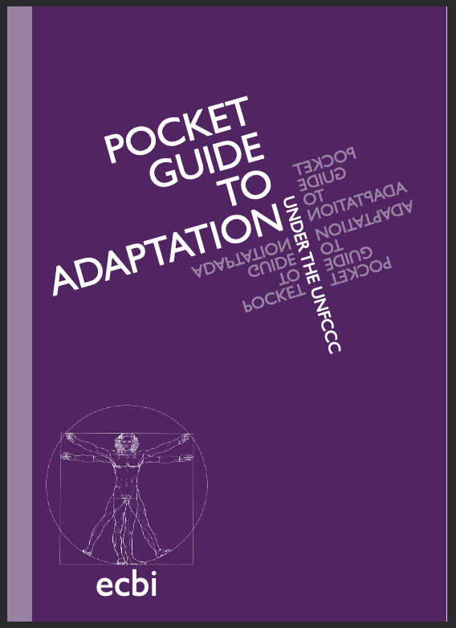
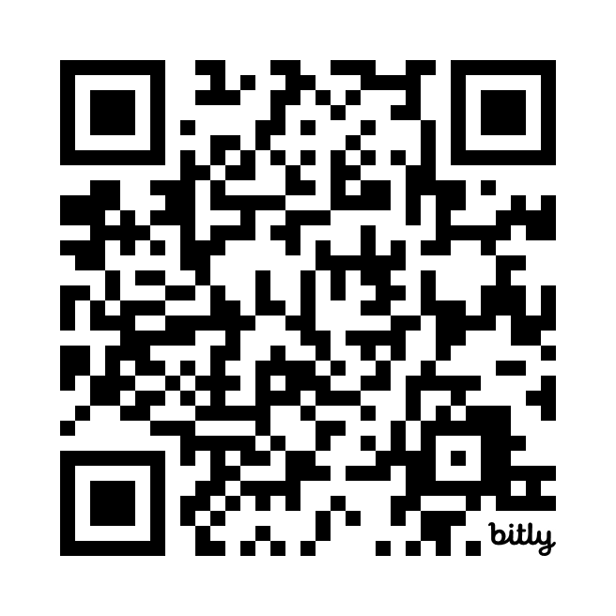
Relevant resources
Guide to the Paris Agreement bit.ly/PAGuideEN
Explainer on Loss and Damage bit.ly/LDexplainer141
Explainer on the New Collective Quantified Goal on Finance bit.ly/NCQG141
SB60 Outcomes Summary bit.ly/SB60SummaryENG
Paris Agreement A to Z App
LRI advice database https://legalresponse.org/legal-assistance/
COP29/CMA6/SB61 provisional agendas: https://unfccc.int/cop29#sessions

Slide 42
THANK YOU !
enquiries@legalresponse.org
www.legalresponse.org

